Slide 1
Bitcoin vs Ethereum:
Operation Much Chaos
Sam Lindy

Slide 2

Problem Statement
I’m an operative for Dogecoin, trying to create a rift between Bitcoin and Ethereum users by sending them targeted ads to inflame tensions. Amidst this chaos, Dogecoin will rise to the top of the crypto world and reign supreme, fren.
Let’s create a model that will help us serve ads to the right users to maximize our limited budget.

Slide 3



Quick Context
$54,290
$2,778
$0.27
much potential

Slide 4
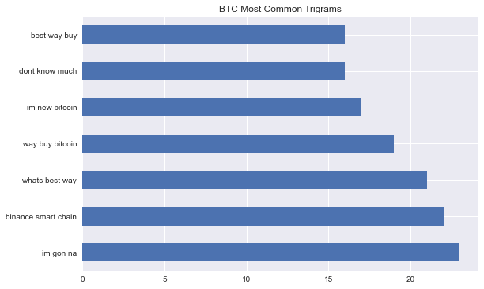
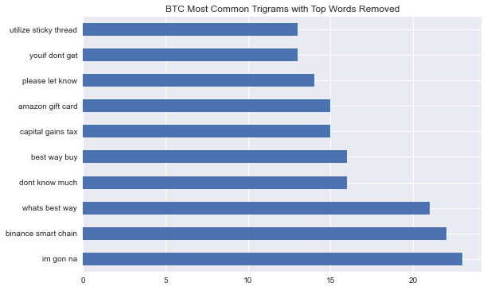
Exploratory Data Analysis - BTC Trigrams

Slide 5
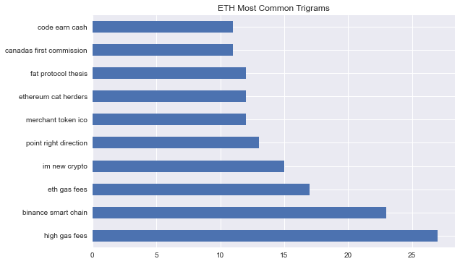
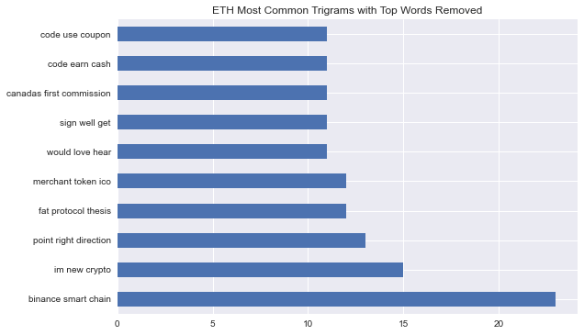
Exploratory Data Analysis - ETH Trigrams

Slide 6

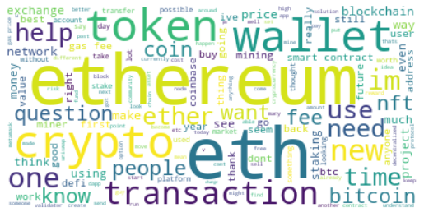
Word Clouds - Not Data Science but look cool

Slide 7
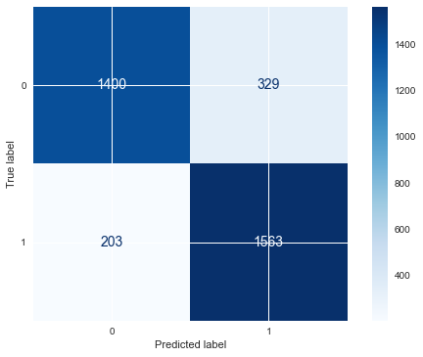
83%
Precision Score
Model 1: Count Vectorizer and Naive Bayes

Slide 8

81%
Precision Score
Model 2: tf-idf and Naive Bayes

Slide 9
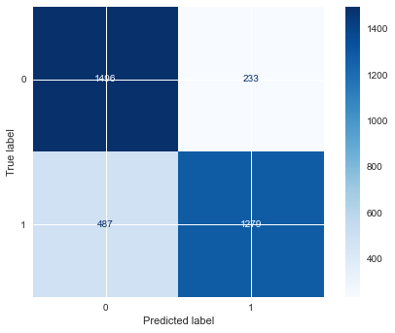
85%
Precision Score
Model 3: Random Forest

Slide 10
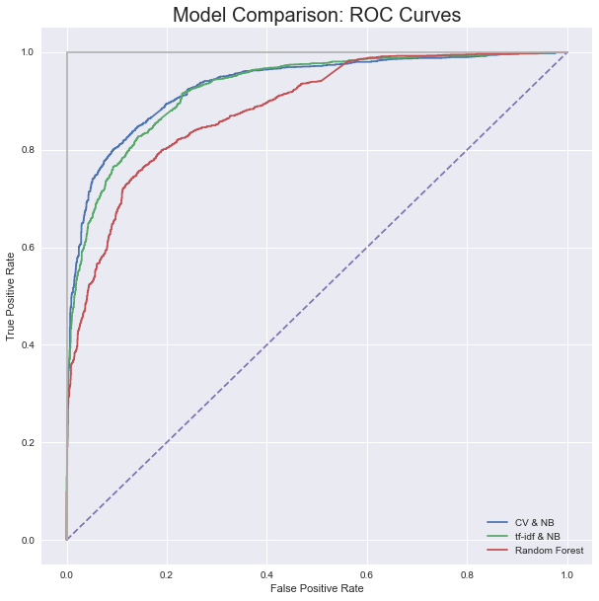
93.1%
Model 1
92.5%
Model 2
88.2%
Model 3
Model Comparison:
AUC-ROC Scores

Slide 11
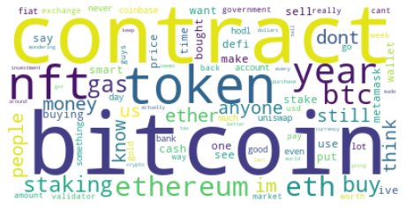
Random Forest: Feature Importance

Slide 12
Incorrectly Categorized Posts
Kadudu888:
What should we tell new panicking newbie who’s selling coz of the 25% dip?
mambell
Privilege:
Does anyone else sometimes remember how lucky we are to own an asset like bitcoin? A community with some of the smartest and forward-thinking minds, defending and fighting for technology so destructive it can change the course of human civilization forever. Removing yourself from the USD price and recognizing the technology for what it is always reminds me to be grateful. I hope in this dip we can reflect on why we are here. Peace
Extremely-Bad-Idea:
Thodex and Vebitcoin have been shut down by Turkish authorities, arrests have been made, and the boss at Thodex is on the run with $2 billion of bitcoins
DeadPrezFolder
Boomer Bullshit:
Someone missed out \n\nhttps://cryptoslate.com/bitcoin-is-an-open-ponzi-scheme-says-black-swan-author/
Twelver313:
The first 10 comments get free sample packs of marijuana and THC gummies by Quad.WTF

Slide 13

Conclusions and Takeaways
Random Forest had best precision score but worst AUC ROC score.
CV & Naive Bayes less likely to deliver ads to incorrect users.
EDA shows top phrases are users asking for advice or talking about specifics pertaining to the currency.
Consider using sentiment analysis to pull out more differences between subreddits. These findings could be used as features to improve model performance.
Model still guessed wrong when obvious words like Bitcoin were in the post.

Slide 14


